Slide 1
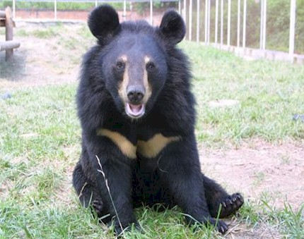
Meet the Moon Bear
Hello , my name is Jasper and I am a moon bear. There are not many of us left in the wild. I hope you can find a way to save the moon bears
Notes:
You could explain that jasper is a bear that was rescued from a bear farm in china by animals asia.

Slide 2
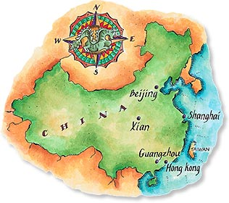
Moon Bears live in Asia
Notes:
Remind them that korea is in asia and that moon bears are part of korean culture and history so it is specially important for us to protect them . My kids thought bear farming only happened in china so you could tell them it happens in korea too

Slide 3
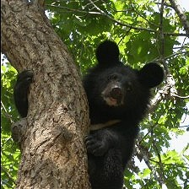
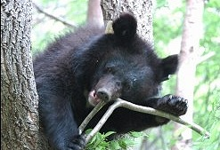
>Moon bears are endangered
>There are only 11 moon bears in the wild in korea today
Notes:
If you haven’t already done so, you could explain what endangered and extinct mean (you could use flash cards of some extinct and endangered animals to help them). Tell them that there are only 11 moon bears in the wild in korea.

Slide 4
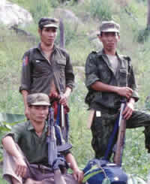
Poaching
Some people take the bears from the wild so that they can make money from selling their gall bladders to make traditional asian medicine.
Notes:
Show them where the gall bladder is in your body and tell them what it does. It helps them to empathize when they realise they have a gall bladder too.

Slide 5
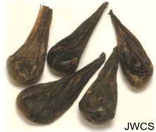
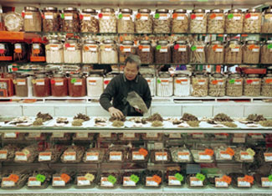
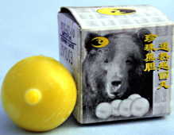
Traditional chinese medicine
Notes:
Explain the pictures. If the kids are korean they will recognise this kind of shop. My kids did and they were concerned that they sold parts of bears and tigers etc. Also explain that we don’t need the medicine from bears because we can make it from plants .

Slide 6
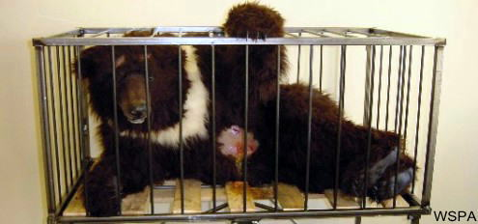
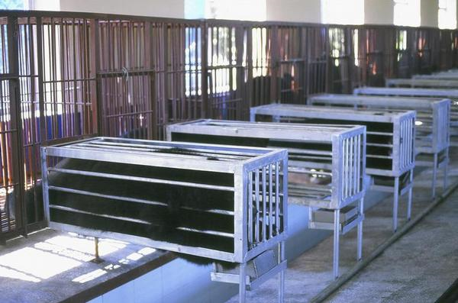
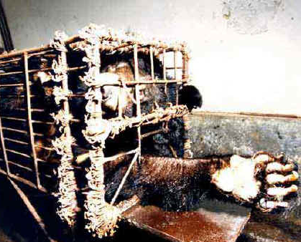
Bear farms
Notes:
Show them how the bears live on farms. I was concerned about upsetting my kids but they were ok. They thought the cages were bad and they thought the bears might be bored and sad because they couldn’t move. If your children don’t volunteer thoughts then ask them how the bear feels.

Slide 7
Why is bear farming bad?
Because taking bears from the wild makes moon bears even more endangered
It makes the bears sad and bored because they can’t move or play with their friends
Because it makes the bears feel sick. Bear bile farming is very painful (ouch!)
Notes:
Ask them why first. Ask them if they would like to live the life of a bear on a farm and if not then why not

Slide 8
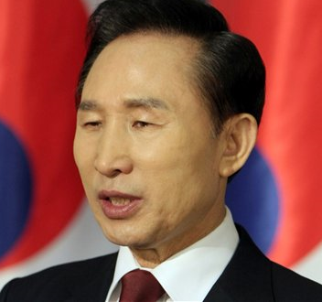

How can we help?
We are going to write a letter to the president asking him to stop bear bile farming in korea.
Notes:
This will hopefully make the children feel engaged with the issue because they can do something positive to help. There are some pictures of letters on the next page

Slide 9
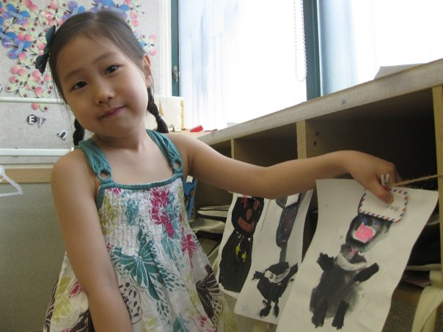
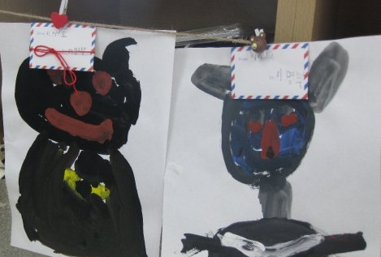
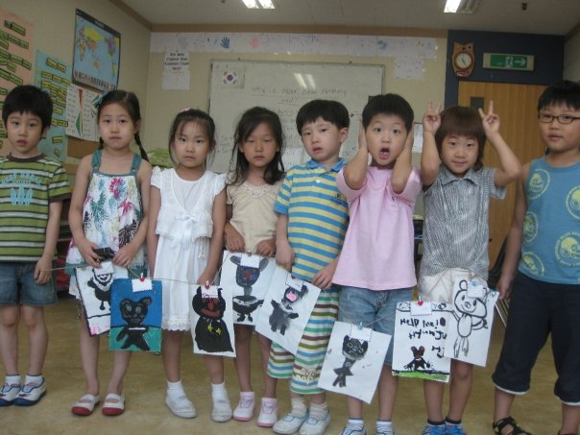
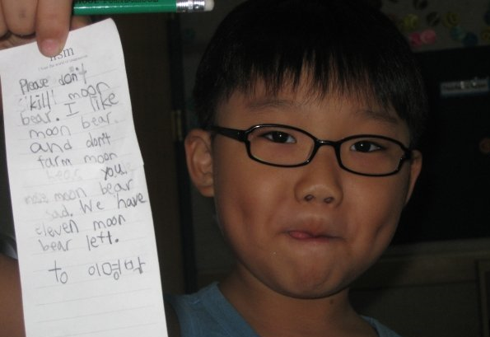
Bear farming protest flags

Slide 10
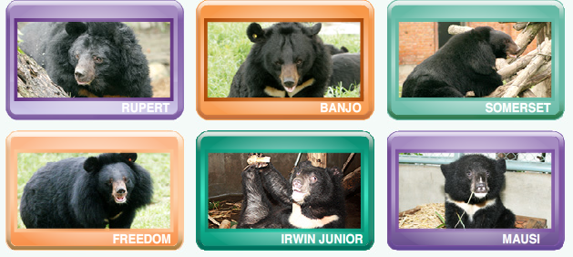
2. Befriend a rescued bear
Notes:
My class chose a bear together to adopt. We are going to hang it up in the class room

